Slide 1
Adult Education & Literacy
Advisory Committee Meeting
(Virtual)
Wednesday
Oct. 19, 2022
1:30 pm CST

Slide 2
October 19th, 2022 Agenda
TWC Welcome / Opening Remarks
TWC AEL Updates
  TWC Adult Education and Literacy Updates
Committee Business Discussion
  Collaboration among Adult and Family Literacy Providers to Meet the Diverse needs of a Community

Slide 3
Opening Remarks
Reps/Commissioner Julian Alvarez III
  Brent Williams
Reps/Commissioner Aaron Demerson
  Brian Owens

Slide 4
TWC AEL Updates

Slide 5
WELCOME, NEW MEMBER
Leslie Cantu, Toyotetsu, Assistant Vice President- Administration
Chair – Board of Directors, Workforce Solutions Alamo
Board Member –Tx Assoc. of Workforce Boards
Member –Tx Dept of Criminal Justice Industry Advisory Committee

Slide 6
AEL Advisory Committee
Member | Location | Representing | Affiliation | Term Expires
Steve Banta (Presiding Officer) | Dallas/ Fort Worth | Nonprofit | Executive Director, Literacy Texas | December 2023
Rita Hernandez | Brownsville | Nonprofit/ Career School | President, Cameron County Education Initiative | April 2023
Jauneen Maldonado | Fort Worth | Workforce Board | Director, Adult Education, Workforce Solutions for Tarrant County | December 2023
Brenda Schofield | Beaumont | AEL Provider | Director of Adult Education and Literacy, Region 5 Education Service Center | December 2023
Leslie Cantu | San Antonio | Business | Asst. Vice President – Toyotesu | October 2024

Slide 7
2022 Outcomes Report
Participants Served – 61,688
IET Services – 7,458
Intensive Services -4,395
>40% in Distance Learning

Slide 8
Career Pathway Enrollment
Number of AEL Participants in Career Pathways Courses by SFY
SFY19 Sep18-Aug19 | 11,185
SFY20 Sep19-Aug20 | 11,341
SFY21 Sep20-Aug21 | 9,782
SFY22 Sep21-Aug22 | 11,696
Unduplicated Total for SFY19-22 | 37,420
Projected Total SFY19-24 | 59,422

Slide 9
Statewide Initiatives
Curriculum for Construction Trades (IET) - $500K
Employer Engagement - $1.2M, 4 grants
Integrated Education and Training in Corrections - $750k, 1 grant
Pre-Apprenticeship Bridge Program/Building Trades - $ 500k, 1 grant
Family Math Literacy Initiative - $500k, 1 grant

Slide 10
AEL Committee Discussion
Presiding Officer – Steve Banta, Literacy Texas

Slide 11
Roll Call Advisory Committee
Member | Location | Representing | Affiliation | Term Expires
Steve Banta (Presiding Officer) | Dallas/ Fort Worth | Nonprofit | Executive Director, Literacy Texas | December 2023
Rita Hernandez | Brownsville | Nonprofit/ Career School | President, Cameron County Education Initiative | April 2023
Jauneen Maldonado | Fort Worth | Workforce Board | Director, Adult Education, Workforce Solutions for Tarrant County | December 2023
Brenda Schofield | Beaumont | AEL Provider | Director of Adult Education and Literacy, Region 5 Education Service Center | December 2023
Leslie Cantu | San Antonio | Business | Asst. Vice President, Toyotesu | October 2024

Slide 12
Current Landscape
Collaboration Among Adult and Family Literacy Providers to Meet Diverse Needs of the Community

Slide 13
Guest Speaker
John Trischitti III, Executive Director, Literacy Coalition of the Permian Basin
“Adult Literacy Needs Assessment”

Slide 14

Literacy Coalition of the Permian Basin

Slide 15
How we got to here…
Abell-Hanger hosts Community Literacy Discussion
AH, FMH, Brown and PSP commit to three years of funding, ED identified, MSS fiscal agent/office
Pre-
2019
July 1
2021-Present
Fall
2019
Winter/Spring
2021
2020
Abell-Hanger Trustees express concern over low Literacy rates/illiteracy
COVID/ Palmer & AH lead discussion with other Foundations, forming a literacy coalition
AIR needs assessment commissioned, 501 © 3 status, org. staffing and infrastructure, programming developed, Literacy Summit/Needs Assessment

Slide 16

Our Purpose
The Literacy Coalition of the Permian Basin will serve as a hub for adult and family literacy awareness, programming and improvement in West Texas and Eastern New Mexico.
Funded by the Permian Strategic Partnership, Abell-Hanger Foundation, FMH Foundation, and the Prentice Farrar & Alline Ford Brown Foundation.
Commissioned a comprehensive needs assessment to inform regional collaboration.

Slide 17

The Challenge
More than 50% of American adults read below a sixth-grade level and almost 20% of adults read below a third-grade level.
Low literacy negatively impacts income, health, and quality of life at a massive cost to the public.
Low literacy persists across generations.
Source: Barbara Bush Foundation’s National Action Plan for Adult Literacy 2021

Slide 18
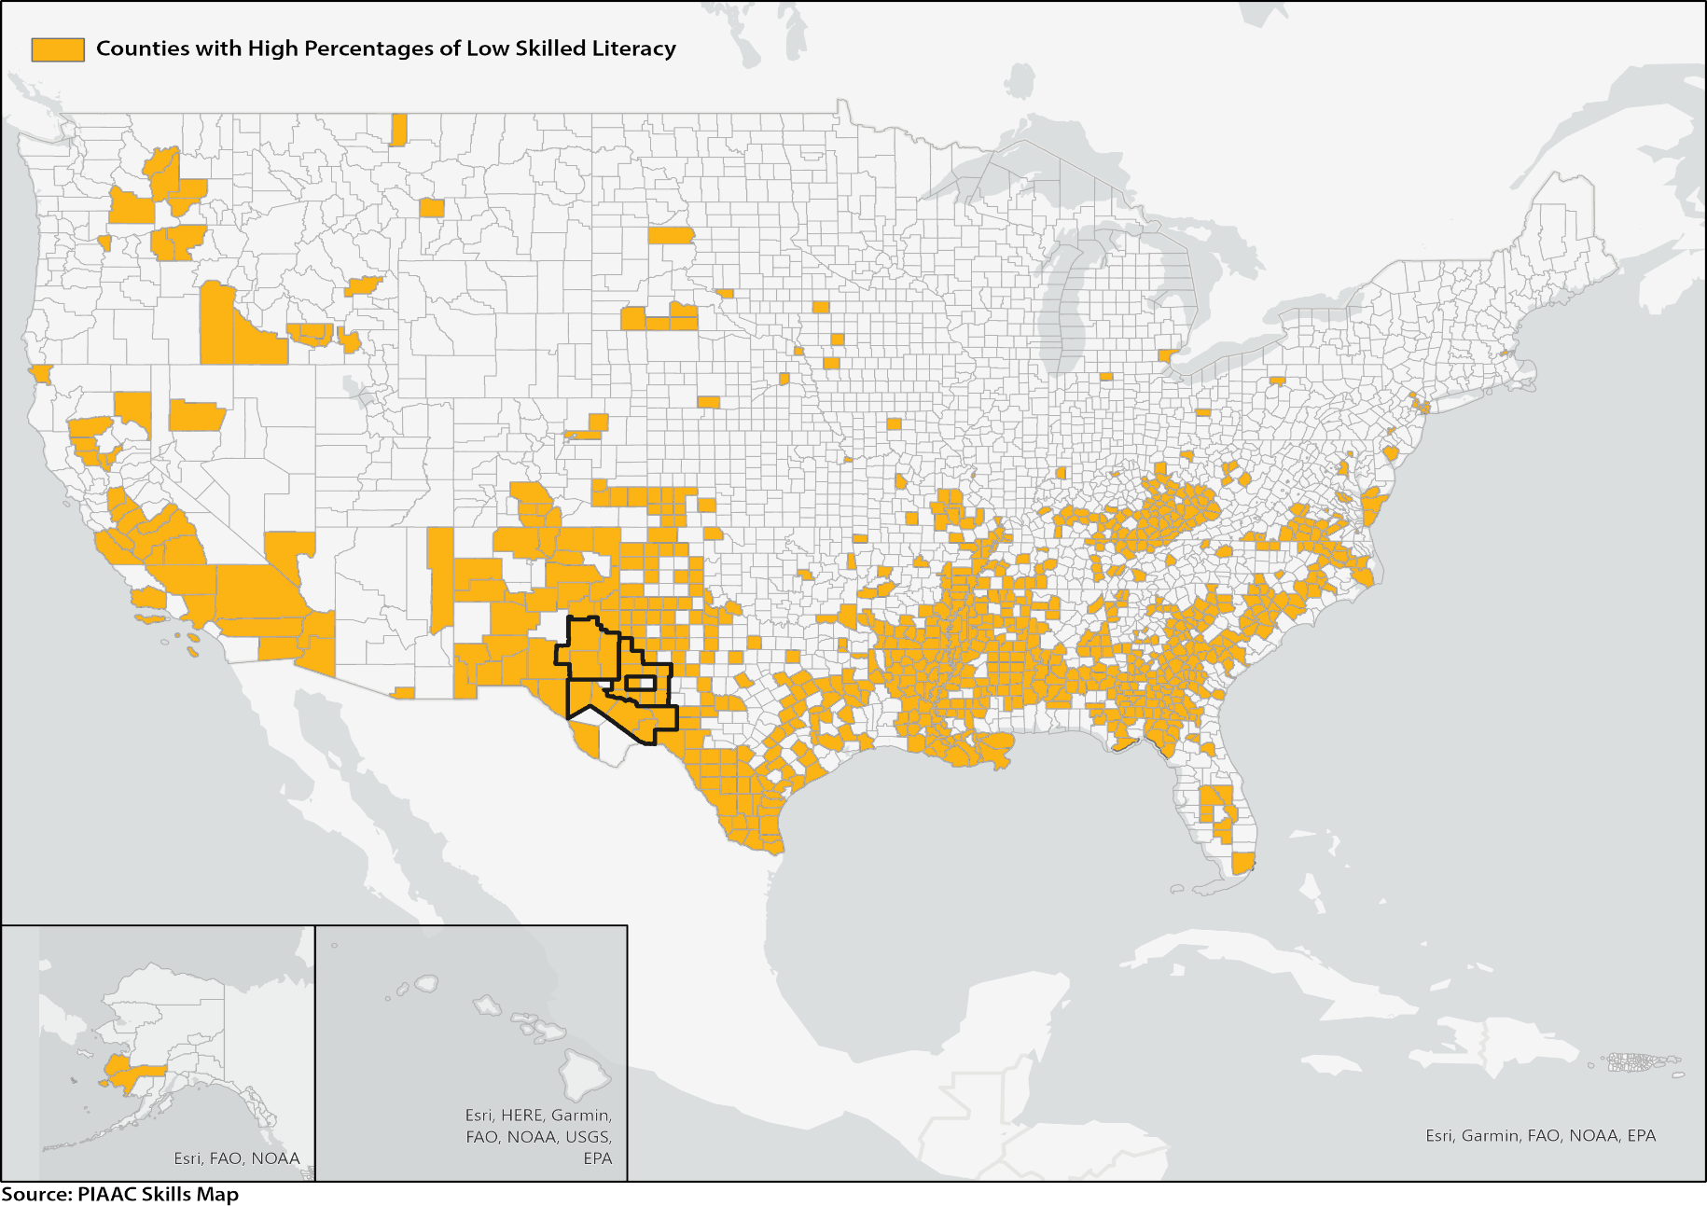
Top Quartile of Counties in the U.S. for Low-Literacy

Slide 19
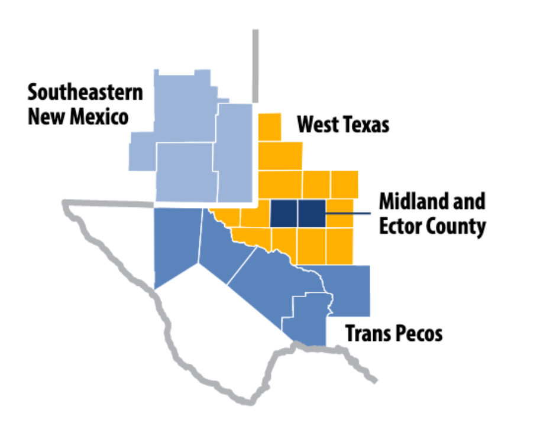
Permian Basin Subregions

Slide 20
Spotlight on Level One
There are an estimated 157,000 adults ages 16-74 with low levels of literacy (Level 1 and below) across the 22 Permian Basin counties. The numbers range from 39,000 adults in Ector to 20 adults in Loving.

Slide 21
Howard County Profile

Slide 22
Join the Coalition!
Program Opportunities
Prison and Probation Programming
Facilitate Program Launch at Community Level
Professional Development (e.g., Rural Libraries Summit)
Support Existing Programs
Sub-granting for Library Resources and Materials
Family Literacy Programming (e.g., ESL, GED, Citizenship, voter registration, etc.)
Coalition Membership Package
Networking and peer dialogues
Literacy assessments
Professional development
Political advocacy and awareness
Leveraged purchasing power
Annual Literacy Summit
Technical support and grant assistance
Curriculum and materials
Annual Dues
Year One: Free from July 2022 to June 2023
Year Two: $95 from July 2023 to June 2024
Notes:
Join the Coalition
TIME: 1:30 – 1:55
SPEAKER: John
Xxx
Xxx
xxx

Slide 23
Committee Discussion
Topic 1: Benefits of collaboration between Adult and Family Literacy Organizations
Topic 2: Policies identified that could enhance collaboration between adult and family literacy organizations

Slide 24
Committee Next Steps
Annual Report Due each year (January) to advise TWC Commission on:
  policies and program priorities that support the development of an educated and skilled workforce in the state;
  statewide curriculum guidelines and standards for AEL services that ensure a balance of education and workplace skills development;
  statewide strategy for improving student transitions to postsecondary education and career and technical education training; and
  a centralized system for collecting and tracking comprehensive data on AEL program performance outcomes

Slide 25
Closing Remarks

Slide 26
Next AEL Advisory Committee Meeting
Tentatively Scheduled: December 7th, 2022

