Slide 1
Advisory Committee Meeting
Wednesday
Sept. 27th , 2023 @ 1:30 pm
TWC- Adult Education and Literacy
Notes:
The blank slides in this presentation are there to show you the layout options. Feel free to delete slides you do not want or to change the layout of the slides (right click then choose Layout from the menu).
To change the slide background picture or TWC logo on this slide, go to View > Slide Master

Slide 2
September 27, 2023
Agenda
TWC Welcome /Opening Remarks
TWC AEL Updates
      Presentations
        Amanda Bergson-Shilcock - National Skills Coalition
        Cindy Fisher – Senior Broadband Program Coordinator
Committee Business and Discussion
      Committee Discussion – 2023 Recommendations

Slide 3
AEL Advisory Committee
Member | Location | Representing | Affiliation | Term Expires
Steve Banta (Presiding Officer) | Dallas/ Fort Worth | Nonprofit | Executive Director, Literacy Texas | December 2023
Dr. Ben Stafford | Port Arthur | Higher Education | Vice President, Workforce and continuing Education | May 2025
Jauneen Maldonado | Fort Worth | Workforce Board | Director, Adult Education, Workforce Solutions for Tarrant County | December 2023
Cindy Fisher | Austin | Texas Broadband Office | Senior Coordinator, Texas Broadband Office | May 2025
Leslie Cantu | San Antonio | Business | Asst. Vice President – Toyotesu | October 2024
Kristina Hartman | Huntsville | Corrections Education | Superintendent, Windham School District | May 2025

Slide 4
Welcome & Opening Remarks

Slide 5
Happenings
Governor’s Proclamation –AEFL Week Sept 18-23
AEL Scholars of the Year Recognition
AEL Request For Applications (RFA) Coming Soon!

Slide 6
Commissioner Remarks
Chairman Daniel
Commissioner Demerson
Commissioner Trevino

Slide 7
Guest Speaker
Cindy Fisher
Senior Broadband Program Coordinator
BroadbandForTexas.com

Slide 8

Closing the Digital Divide in Texas
Cindy Fisher, Senior Broadband Program Coordinator
BroadbandForTexas.com

Slide 9
Snapshot: Digital Divide in Texas
We are more interconnected and reliant on
digital services everyday, especially post-pandemic…
… while many of our most vulnerable communities are being left behind
7M
Texans without Access to Broadband
3.6M
Texas households who experience affordability challenges
3.8M
Texans who face digital literacy challenges

Slide 10

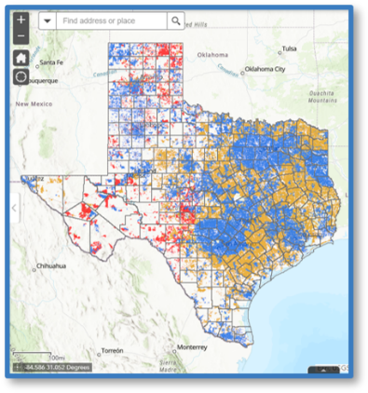
Texas Broadband Development Office
House Bill 5 (87R)
Created the Broadband Development Office (BDO) at the Texas Comptroller of Public Accounts
Required BDO to:
  Create a state broadband plan (June 2022)
  Create a broadband development map (January 2023)
  Implement a broadband development program to administer broadband expansion grants
  Serve as an information clearinghouse for state & federal funding opportunities in Texas
Created the BDO Board of Advisors
  Chaired by the Comptroller with seven appointed members by the Governor, Lieutenant Governor, & Speaker

Slide 11

What is Broadband?
Federal Communications Commission (FCC) defines broadband as a minimum of 25 Mbps for download & 3 Mbps for upload (25/3)
  Federal funding programs target 100/20 for future projects
Interchangeable with “high-speed internet”
Two broadband delivery technologies:
  Physical wire and cables (“wired broadband”)
  Wireless technology (“wireless broadband”)
Coaxial Cable
Fiber Optics
Satellite
Microwave

Slide 12
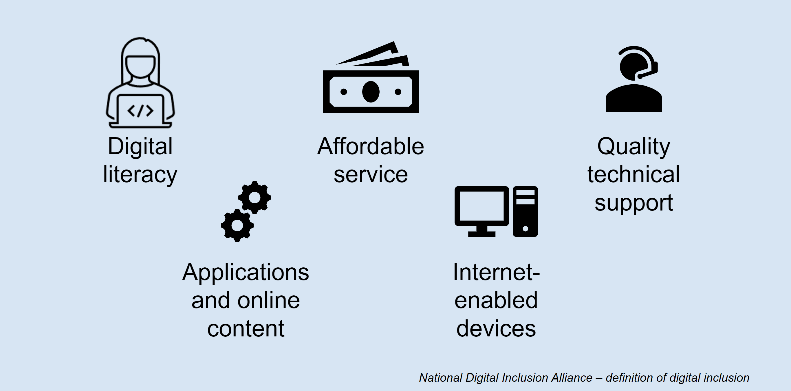
What is Digital Opportunity?

Slide 13
Infrastructure and Jobs Act (IIJA)
The Texas Broadband Development Office is the “Administering Entity” for IIJA Funds
Broadband Equity, Access, & Deployment (BEAD) - $3.3b​
Expands high-speed Internet access by funding planning, deployment, and adoption​
$5M in planning funds to:​ Help close the availability gap​ Develop Five-Year Action Plan​ Conduct research and data collection​ Facilitate publications, outreach, and communications support​
Texas Digital Opportunity Plan (TDOP) – Funds TBD​
​Ensures people and communities have the skills and tech to participate in the digital economy​
$3M in planning funds to:​ Help close the digital opportunity gap​ Develop Digital Opportunity Plan​ Reach covered populations​ Foster partnerships through engagement; establish a planning coalition ​

Slide 14
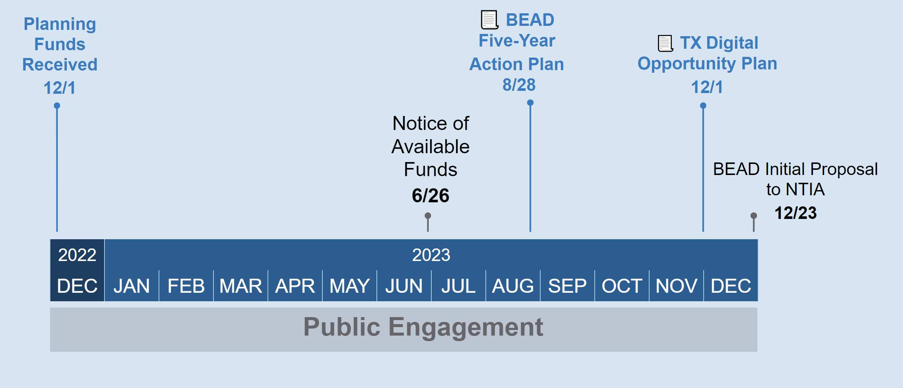
IIJA Program Planning Timeline
Certain NTIA actions start the timers for deliverables, which in turn necessitate the public engagement timeline​

Slide 15
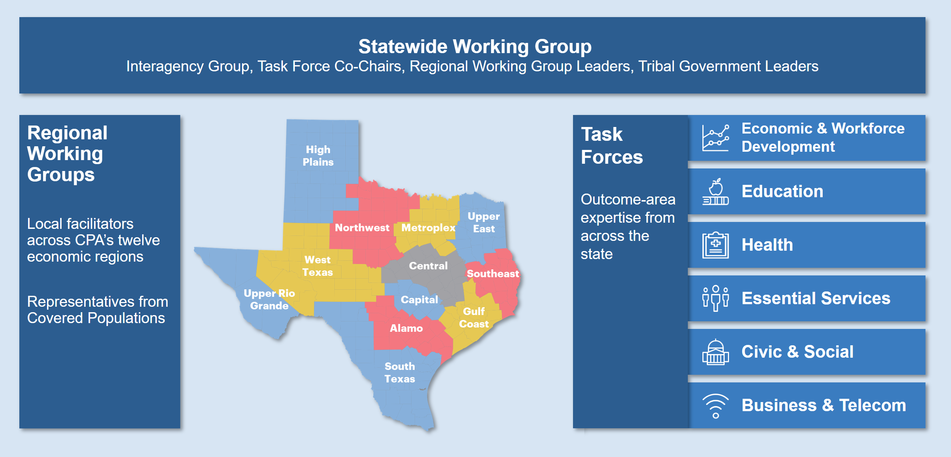
Public Engagement
Channeling community input and local coordination through three sets of working groups

Slide 16
Covered Populations
Groups that are negatively impacted by the digital divide
Individuals in a household with income below 150 percent of poverty level
Aging individuals
Incarcerated individuals (other than individuals who are incarcerated in a Federal correctional facility)
Veterans
Individuals with disabilities
Individuals with a language barrier, including individuals who are English learners; and have low levels of literacy;
Individuals who are members of a racial or ethnic minority group; and
Individuals who primarily reside in a rural area

Slide 17
What we heard:
Public Meetings:
Across regions, affordability and availability emerged as primary reasons households may not subscribe to the internet.
Public meetings provided the opportunity to hear from residents about the unique ways in which their communities are impacted by digital opportunity gaps.
Survey Results:
Over 10,000 responses.
Response from every county!
Nearly 7 percent of rural respondents indicated that they cannot connect to the internet at home. The majority of that group indicated that home internet is not available or is too expensive.
Of households that report no internet access, 61 percent indicate this is because they do not need it or are not interested, and 25 percent indicate that affordability is the main barrier.
At least 85 percent of respondents felt at least somewhat comfortable performing tasks using the internet, from paying bills to more sophisticated tasks such as deleting cookies or setting up protection against phishing and spam.

Slide 18
What’s Next:
Public Comment Period
Initial Proposal and Texas Digital Opportunity Plan (TDOP) will open this Fall
Help provide us with feedback and guidance to strengthen our plan.
Some tips:
  Support your comment with substantive data, facts, and opinions. When possible, provide your lived experience in your comment.
  Clearly identify the section you are commenting on and include the section number. Although comments should be clear and concise, there is no minimum or maximum length for an effective comment.
  If you disagree with an aspect of the Plan, suggest an alternative and include an explanation and/or analysis of how the alternative might meet the same objective or be more effective.
  Include pros and cons and trade-offs in your comment. Consider other points of view and respond to them with your views. Include examples of how the proposed programs and activities would impact your life and work positively or negatively.

Slide 19
Questions?
833-3-TEXBDO
Broadband@cpa.texas.gov
BroadbandForTexas.com

Slide 20
Guest Speaker
Amanda Bergson-Shilcock
Senior Fellow
National Skills Coalition

Slide 21
Today’s conversation
What new federal funding is coming to Texas to support adults’ digital skills?
What do we know about the demands for digital skills that adult learners are facing in the job market?
How can adult education leaders take action?

Slide 22
About National Skills Coalition
Jobs that require skills training are the backbone of our economy.
National Skills Coalition fights for a national commitment to inclusive, high-quality skills training so that more people have access to a better life, and more local businesses see sustained growth.

Slide 23

The digital divide isn’t just about broadband or hardware…
It’s also about skills.

Slide 24
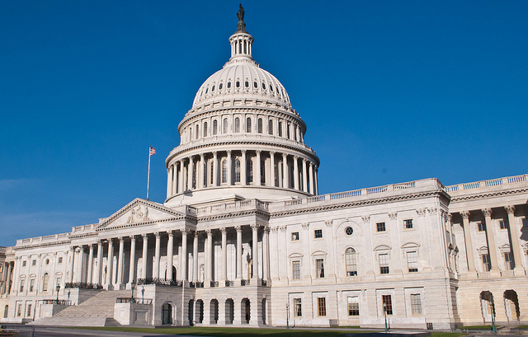
Congress is sending more than $1 billion to Texas
The 2021 federal infrastructure legislation invests heavily in broadband & digital equity.

Slide 25
The Infrastructure Investment
The Infrastructure Investment and Jobs Act (IIJA) included:
$42.5 billion nationwide for the Broadband Equity, Access, and Deployment (BEAD) program
$2.75 billion nationwide for the Digital Equity Act
This funding is being overseen by the US Commerce Department’s National Telecommunications and Information Administration (NTIA).

Slide 26
The Digital Equity Act includes two types of funding for Texas:
Formula funding that will go to the Texas Broadband Development Office before being re-distributed down to the local level
Federal discretionary competitive grants for which states and other eligible entities can apply directly to National Telecommunications and Information Administration (NTIA)

Slide 27
What’s the timeline?
Right now: Texas is engaged in its 12-month Digital Equity planning process (known in TX as the Digital Opportunity Plan). The planning process is required to engage a broad array of stakeholders, and states are also required to post their draft plans for a 30-day public comment period
By December 2023: TX will submit its 5-year Digital Equity Plan to NTIA
Early 2024: NTIA releases formula funds to states (“Digital Equity Capacity Grants”)
Slightly later in 2024: NOFO released for competitive grants to states and other eligible entities (“Digital Equity Competitive Grants”)

Slide 28
DE Act “covered populations” overlap with adult learners
Individuals in a household with income below 150 percent of poverty level
Aging individuals
Incarcerated individuals (other than individuals who are incarcerated in a Federal correctional facility)
Veterans
Individuals with disabilities
Individuals with a language barrier, including individuals who are English learners; and have low levels of literacy;
Individuals who are members of a racial or ethnic minority group; and
Individuals who primarily reside in a rural area

Slide 29
AE providers will likely be eligible to apply for federal discretionary grants
Entities eligible to apply directly to the federal government:
  A political subdivision, agency, or instrumentality of a State
  An Indian Tribe, an Alaska Native entity, or a Native Hawaiian organization
  A foundation, corporation, institution, or association that is a not-for-profit entity and not a school
  A community anchor institution [includes community colleges]
  A local educational agency
  An entity that carries out a workforce development program
  A partnership between any of the preceding entities
  A partnership between any of the preceding entities and an entity that the Assistant Secretary determines to be in the public interest; and is not a school (Cannot be or have been an administering entity under the DE Capacity Grant Program)

Slide 30

What types of services can be provided with DE funding?
Activities that many adult education programs are already providing!

Slide 31
Entities receiving federal competitive grants must engage in at least one of these activities:
(i) To develop and implement digital inclusion activities that benefit covered populations.
(ii) To facilitate the adoption of broadband by covered populations in order to provide educational and employment opportunities to those populations.
(iii) To implement, consistent with the purposes of this title— (I) training programs for covered populations that cover basic, advanced, and applied skills; or (II) other workforce development programs.
(iv) To make available equipment, instrumentation, networking capability, hardware and software, or digital network technology for broadband services to covered populations at low or no cost.
(v) To construct, upgrade, expend, or operate new or existing public access computing centers for covered populations through community anchor institutions.
(vi) To undertake any other project and activity that the Assistant Secretary finds to be consistent with the purposes for which the Program is established.

Slide 32

Let’s talk about BEAD funding.
Texas will get $3.3 billion in BEAD funds.

Slide 33
BEAD gives states funding to:
Bring broadband (high-speed) internet to unserved people who don’t have any internet access right now
Bring broadband to under-served people who have only slow internet access right now
Bring broadband to Community Anchor Institutions (including schools, libraries, hospitals, higher education institutions, and others)
Spend on other “non-deployment” broadband-related activities, including workforce development

Slide 34
Yes, states can spend BEAD money on activities other than laying fiber
States’ primary spending will be on “last-mile deployment” to get broadband to un/underserved residents and Community Anchor Institutions.
This last-mile money can be used for (among many other uses):
  Training for cybersecurity professionals who will be working on BEAD-funded networks
  Workforce development, including Registered Apprenticeships and pre-apprenticeships, and community college and/or vocational training for broadband-related occupations to support deployment, maintenance and upgrades
Learn more in the federal BEAD Notice of Funding Opportunity (NOFO) from May 2022.

Slide 35
If states still have money left over after “last mile” deployment…
All states have the right to spend BEAD money on other purposes as long as they have a plan for getting service to un/underserved residents and Community Anchor Institutions. (They don’t have to have completed all of the activities in their plan, they just have to have a clear plan.)

Slide 36
Some ways states can spend their non-deployment money:
Digital literacy/upskilling (from beginner to advanced)
Computer science, coding, and cybersecurity education programs
Implementation of Digital Equity plans (supplementing but not duplicating or supplanting DE Act funds)
Broadband sign-up assistance and programs that provide technology support
Multi-lingual outreach to support adoption and digital literacy
Prisoner education to promote pre-release digital literacy, job skills, online job-acquisition skills, etc.
Digital navigators
Non-exhaustive list. See BEAD Notice of Funding Opportunity (NOFO) for details.

Slide 37
The TX Broadband Development Office is overseeing the 5-year BEAD Action Plan
The plan must include strategies to ensure an available and highly skilled workforce…including plans to attract, retain or transition the skilled workforce needed to achieve the plan’s goals, including describing the involvement and partnerships of sub-grantees, contractors, and subcontractors with:
  Existing in-house skills training programs, unions and worker organizations, community colleges and public school districts;
  supportive services providers;
  Registered Apprenticeship programs and other labor-management training programs;
  or other quality workforce training providers.

Slide 38
What happens once the feds approve Texas’s plans?
States have to use a competitive process to dispense BEAD funding
States are allowed to give extra weight to grant applicants who have enforceable commitments related to equitable workforce development and job quality objectives
Projects funded under BEAD have a 25% match requirement, which can be met using $ from business, nonprofit, philanthropic, or local/state government sources. In general, federal money cannot be used for the match, with a few exceptions such as CARES and ARPA
In-kind matching is fine (doesn’t have to be cash)

Slide 39

What does all this mean for adult learners?
We know that adult learners often enroll in classes to get a job or get a better job.

Slide 40

So we researched employers’ demand for digital skills
In collaboration with the Federal Reserve Bank of Atlanta, we looked at 43 million “Help Wanted” ads from 2021
We hand-coded skills to understand which ones were definitely digital, likely digital, or not digital

Slide 41
Virtually all of today’s jobs require digital skills
47%
of jobs require definitely digital skills
45%
of jobs require likely digital skills
Definitely digital: Microsoft Excel; Python language
Likely digital: Bookkeeping; survey design
Not digital: Ironing; changing diapers; problem-solving
92%
of Jobs in U.S. require definitely digital or likely digital skills
8%
of jobs require no digital skills

Slide 42
TX employers are close to national average in requiring digital skills
Notes:
90 and 43 percent

Slide 43
Even entry-level jobs require digital skills
Educational credential required | Percentage of job ads requiring likely digital skill | Percentage of job ads requiring definitely digital skill
High school diploma | 94% | 46%
Associate’s degree | 97% | 47%
Bachelor’s degree | 99% | 74%
Master’s degree | 97% | 46%
Ph.D. | 97% | 39%
National data. For details, see full report: Closing the Digital Skill Divide (National Skills Coalition, 2023.)
Notes:
Jobs that require a HS diploma or an Associate degree are circled here in yellow. As you can see, they are overwhelmingly likely to require digital skills.

Slide 44

Learn more in our full report:
Closing the Digital Skill Divide
https://tinyurl.com/DigitalSkillDivide

Slide 45

1. Start preparing now for competitive grant opportunities in 2024.
How can adult education leaders
take action?

Slide 46

2. Advocate for investment in proven digital skill-building strategies:
Industry sector partnerships between educational institutions and employers
Contextualized and integrated learning such as IET
Industry-recognized credentials that are portable and stackable
More details in this report: www.tinyurl.com/BoostingDL

Slide 47

Create or expand work-based learning programs that allow adult learners to upskill without debt.
3. Ensure adult learners can qualify for new broadband workforce jobs
Notes:
Apprenticeship is a known model for training workers in infrastructure fields. Due to its “earn and learn” approach, apprenticeship can be a particularly powerful job training strategy for workers who have lost their jobs during the pandemic and need to train for a career while also earning a paycheck. Public policies intended to expand apprenticeship can diversify infrastructure hiring pipelines if they invest in equity-advancing practices, such as pre-apprenticeship and mentoring programs.
Pre-apprenticeship programs that are aligned with industry needs and provided in partnership with culturally and linguistically competent organizations can provide valuable on-ramps to apprenticeship programs for workers of color and women. Likewise, investments aimed at diversifying apprenticeship mentors can foster workplace inclusion and leadership for underrepresented workers.
Policy leaders can also make debt-free financial aid more readily available for short-term training programs that meet quality assurance standards and are offered by public community and technical colleges. Debt free financial aid is important for building the infrastructure workforce in an equitable way since Black and Latinx students take on a disproportionate amount of student debt due to the racial wealth gap.

Slide 48

…to establish industry partnerships for broadband workforce development, and increase their capacity to engage in equity-advancing practices.
4. Collaborate with workforce development stakeholders…
Notes:
2. Invest in industry partnerships in the infrastructure field and support their capacity to engage in equity-advancing practices.
Industry partnerships bring together local businesses, unions and worker organizations, community colleges, training providers, and community organizations, to develop local and industry-specific workforce strategies. Industry partnerships are a proven model for helping workers enter and advance in a local industry and helping local companies support an inclusive talent ecosystem. Industry partnerships also address specific challenges identified by industry stakeholders representing both workers and businesses.
Industry partnerships have the potential to expand access to quality infrastructure careers for people of color and women. Since industry partnerships intentionally broker training, hiring, and advancement opportunities between workers and employers within a particular sector, they can be used to disrupt occupational segregation if they are equity focused. They can also broker apprenticeship strategies, validate industry-specific credentials, and connect community college workforce programs with employers.
Policymakers can specifically invest in industry partnerships’ capacity to assess industry needs, convene partners to develop and align workforce strategies and programs, and broker services. While these activities are critical, they are rarely directly funded by public dollars.
Policymakers can also fund infrastructure industry partnerships to develop training, hiring, and advancement strategies intentionally designed to increase opportunities for people of color and women, and to help employers, unions, and training providers adopt and measure equitable, inclusive practices. Such funding can be coupled with technical assistance and learning communities that build partnerships’ capacity to engage in equity-advancing practices.

Slide 49

Time for your questions!

Slide 50
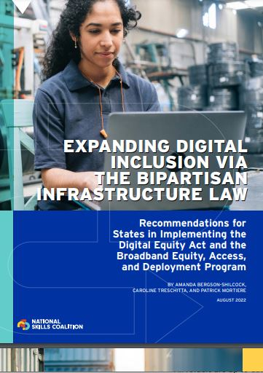
Knowledge to action:
Additional resources
Check out NSC’s Digital Equity Act 101 fact sheet
NSC’s Digital Equity Act and BEAD recommendations (see right) may also be helpful

Slide 51
Stay in touch
Amanda Bergson-Shilcock
Senior Fellow 215-285-2860 (mobile)
amandabs@nationalskillscoalition.org

Slide 52
AEL Committee Discussion
Presiding Officer- Steve Banta, Literacy Texas

Slide 53
The AEL Advisory Committee met last June to refine it’s 2022 recommendations to the Commission. This resulted in two primary recommendations.

Slide 54
Blank

Slide 55
Closing Remarks

Slide 56
Next AEL Advisory Committee
Meeting
Tentatively Scheduled:
December 6th, 2023

