Slide 1



Education Outreach
Services
From twc

Slide 2
Workforce Career And Education Outreach Specialists
Since 2014

Slide 3
Circa May 2019
1 TWC
State-Level
Outreach
Team
and…

Slide 4
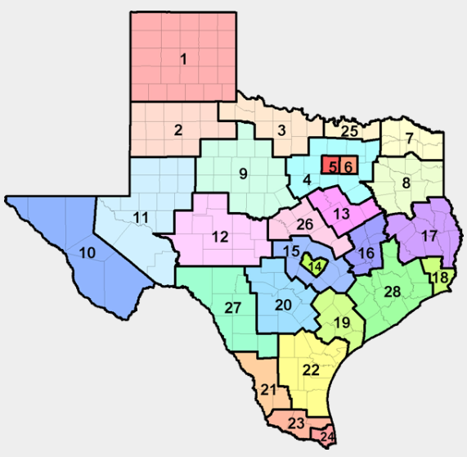

7 Regional Workforce Specialist Teams
Workforce Development Area (WDA)
7 North East Texas (Texoma)
9 West Central Texas (Abilene)
10 Borderplex (El Paso)
14 Capital Area (Austin)
23 Lower RGV (McAllen)
26 Central Texas (Belton/Temple)
28 Gulf Coast (Houston)

Slide 5


Regional Teams Breakdown
Regional Teams
Borderplex
El Paso
Capital Area
Austin
Central TX
Temple/Killeen
Coastal Bend
Corpus Christi
Lower RGV
McAllen
NE Texas
Texarkana
Rural Capital
Around Austin
SE Texas
Beaumont
Texoma
Bonham
West Central TX
Abilene
Deep East
Lufkin
Greater Dallas
Dallas
Gulf Coast
Houston
Heart of Texas
Waco

Slide 6
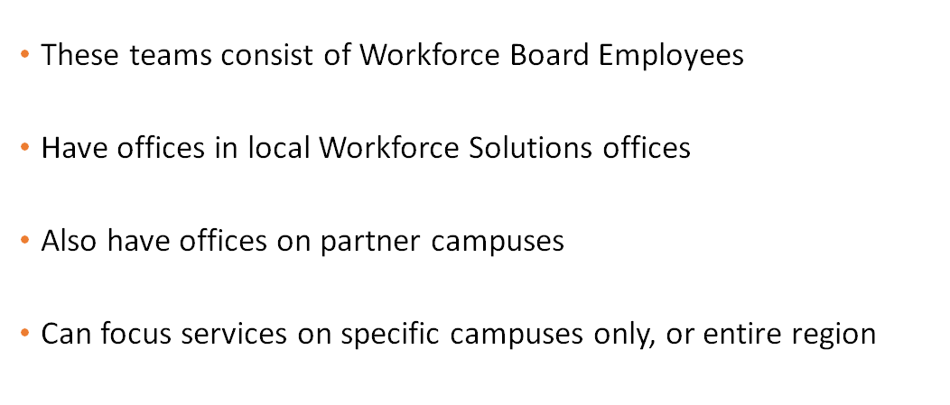

Important Considerations for Regional Teams

Slide 7

One Team
Mentality
Work with:
  Students & Parents
  Teachers & Counselors
  Foster Youth
We provide
  Resources
  Tools
  Services
Wear a lot of hats
Resource
Partnership
Shared
Resources
Support &
Collaboration
Shared
Best Practices

Slide 8
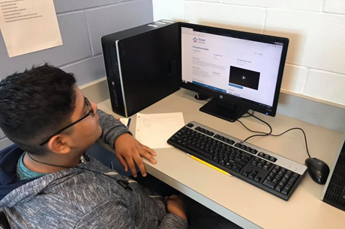
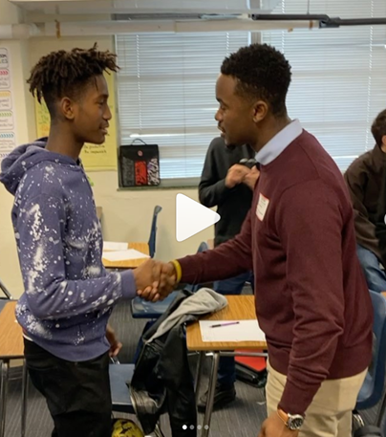
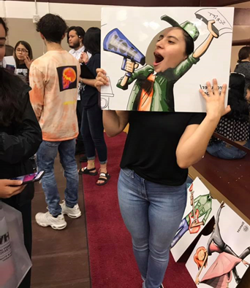
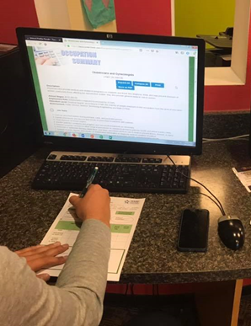
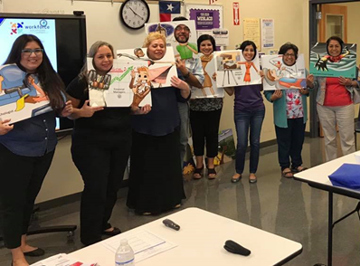

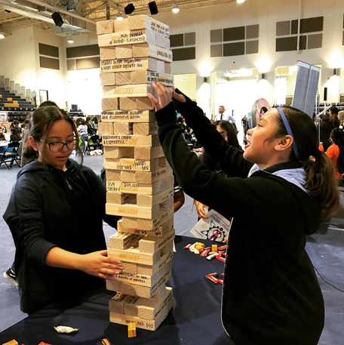
What We Provide: A Brief Summary
Labor Market Data Sharing
Career Exploration Services
Career Development Services
Professional Development
Job Fair Participation/Coordination
WBL Opportunities
Partnership/Network Building

Slide 9

Let’s Talk About Data
&
The Impact of our Teams
In the Past 2 Years

Slide 10
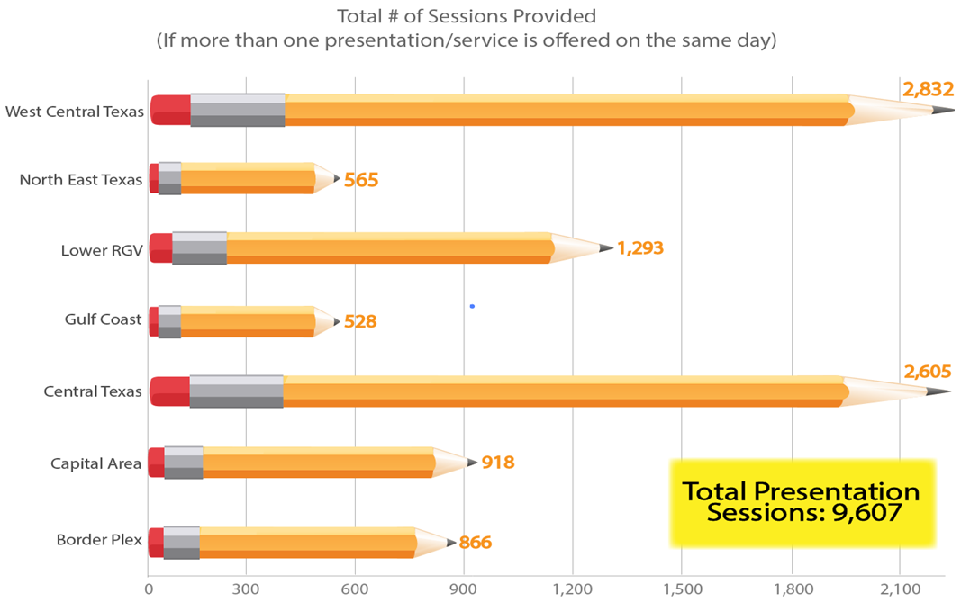
Total Sessions Provided

Slide 11
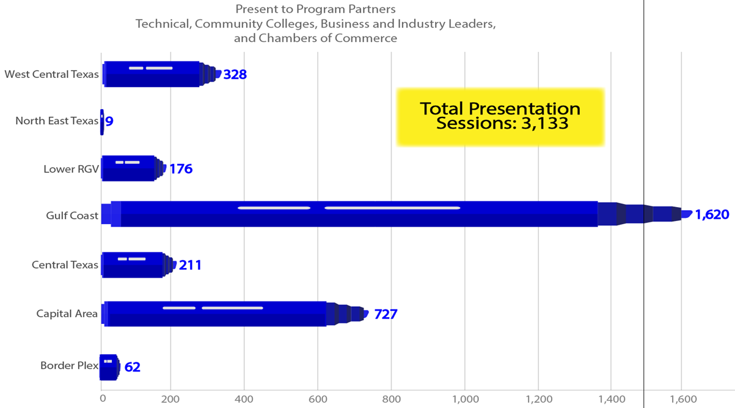
Presentations to Partners

Slide 12
Postsecondary Options
Pathways 180,146

Slide 13
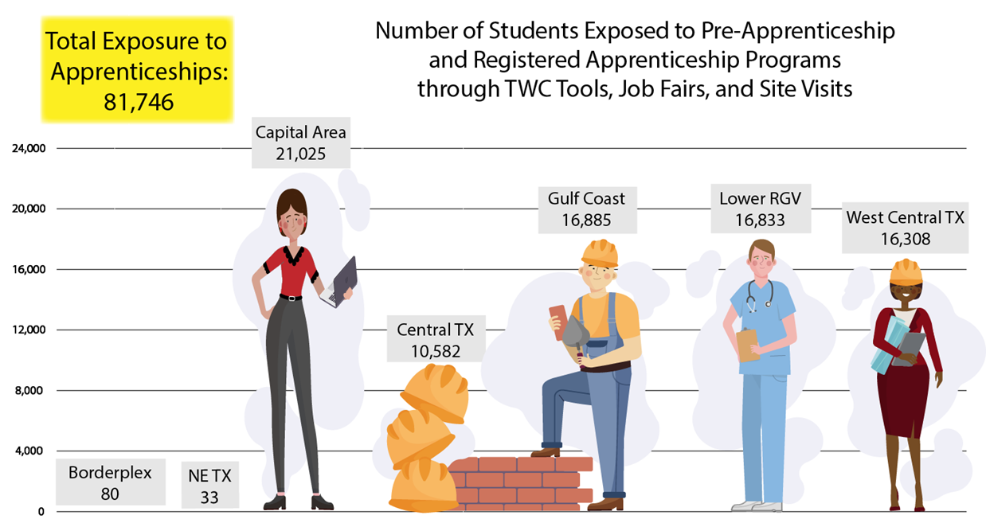
Apprenticeships

Slide 14
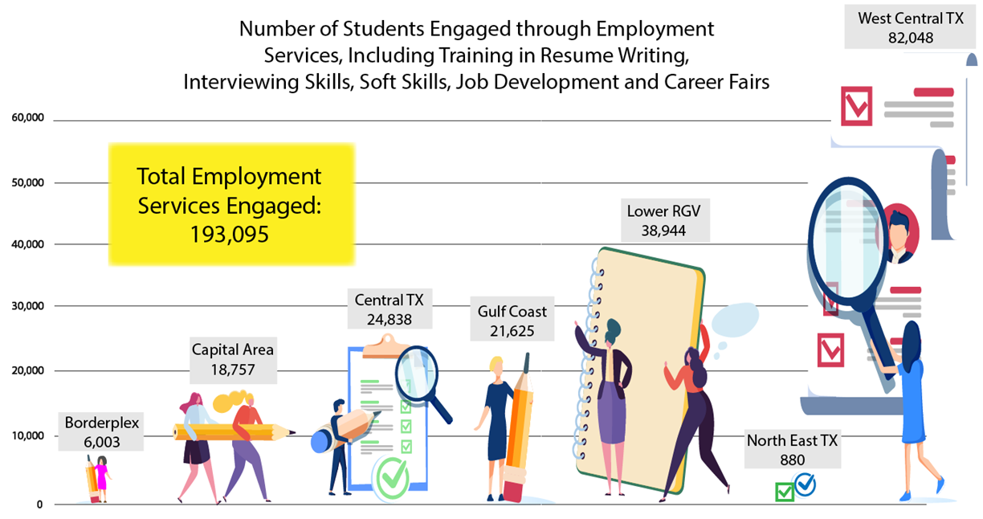
Career Readiness Workshops

Slide 15
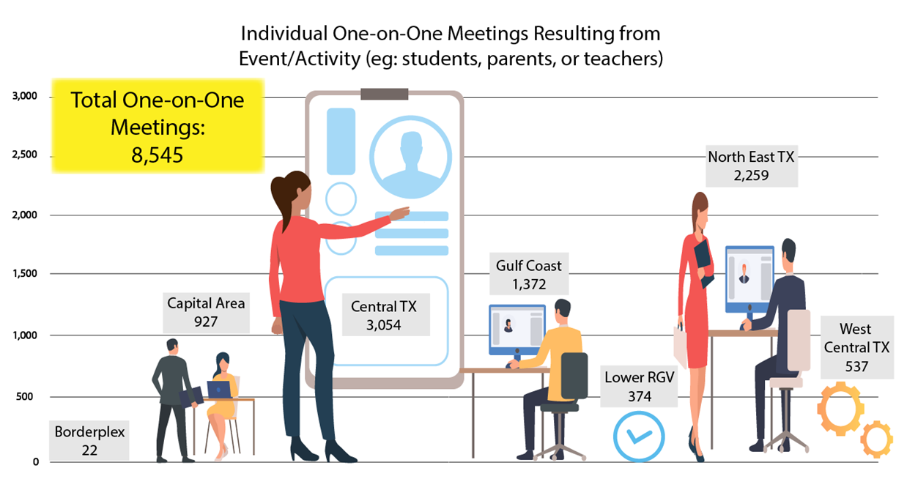
One-on-One Meetings

Slide 16
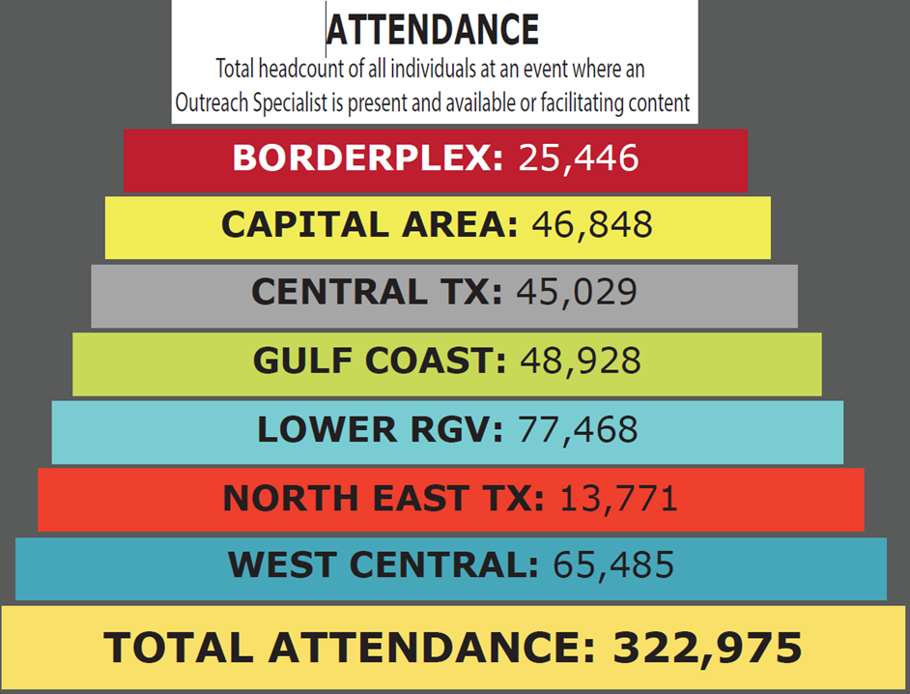

Overall attendance

Slide 17
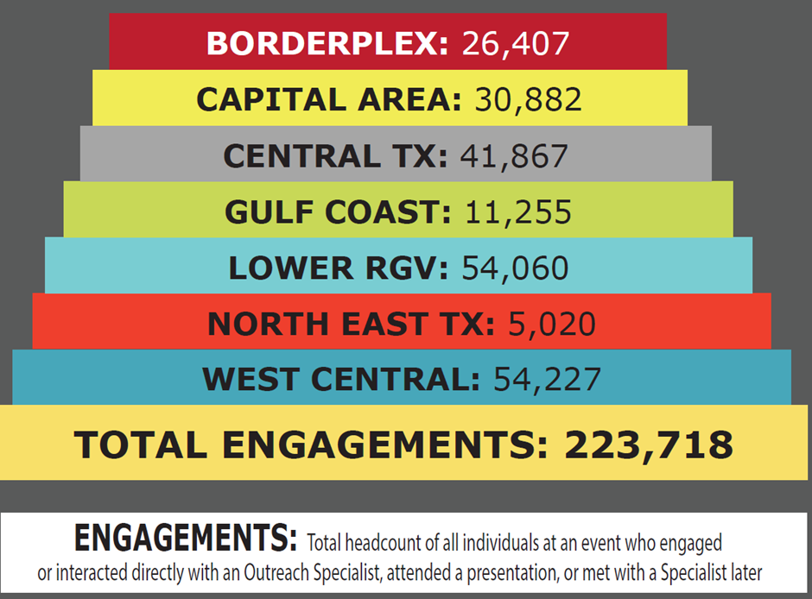

Total Engagements

Slide 18

Take a look at us in action

Slide 19
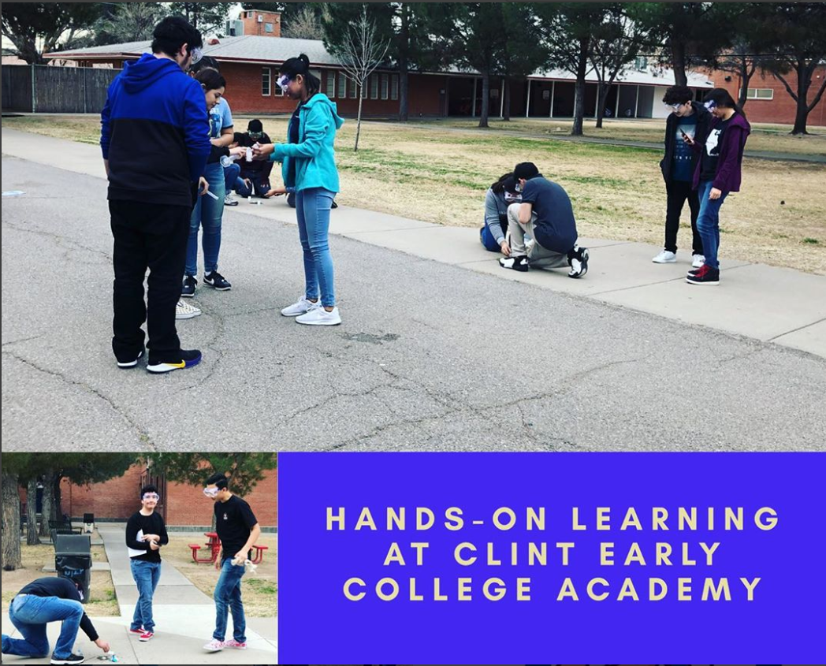
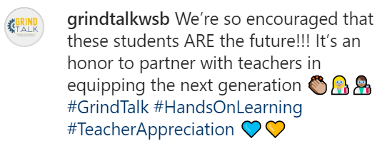
Borderplex

Slide 20
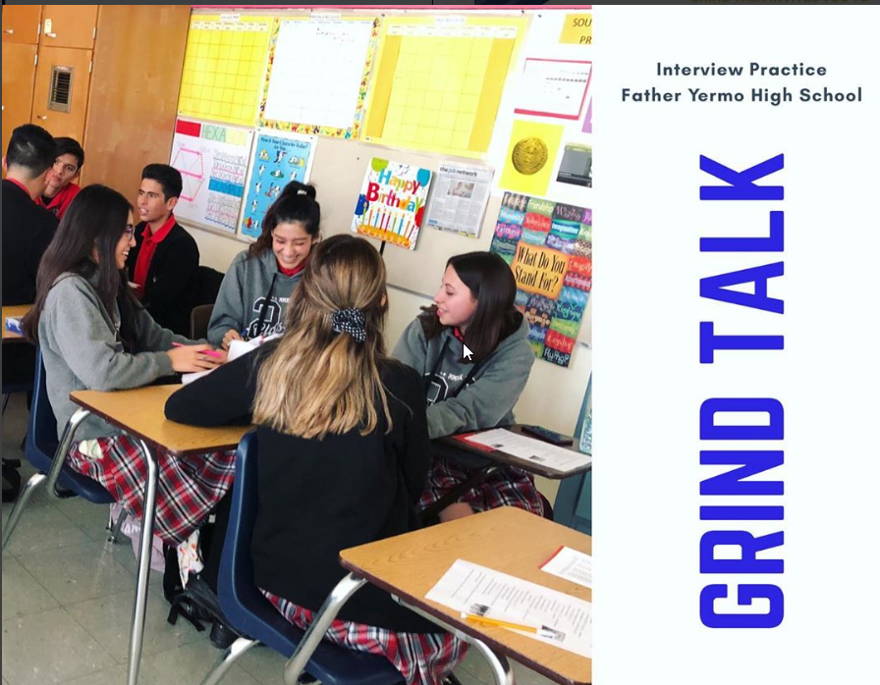
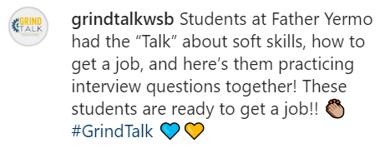
Borderplex 1

Slide 21
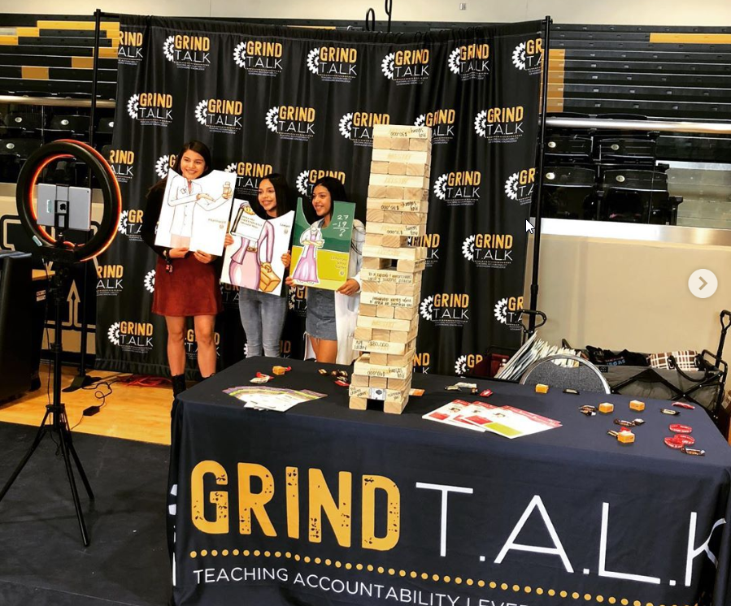

Borderplex 2

Slide 22
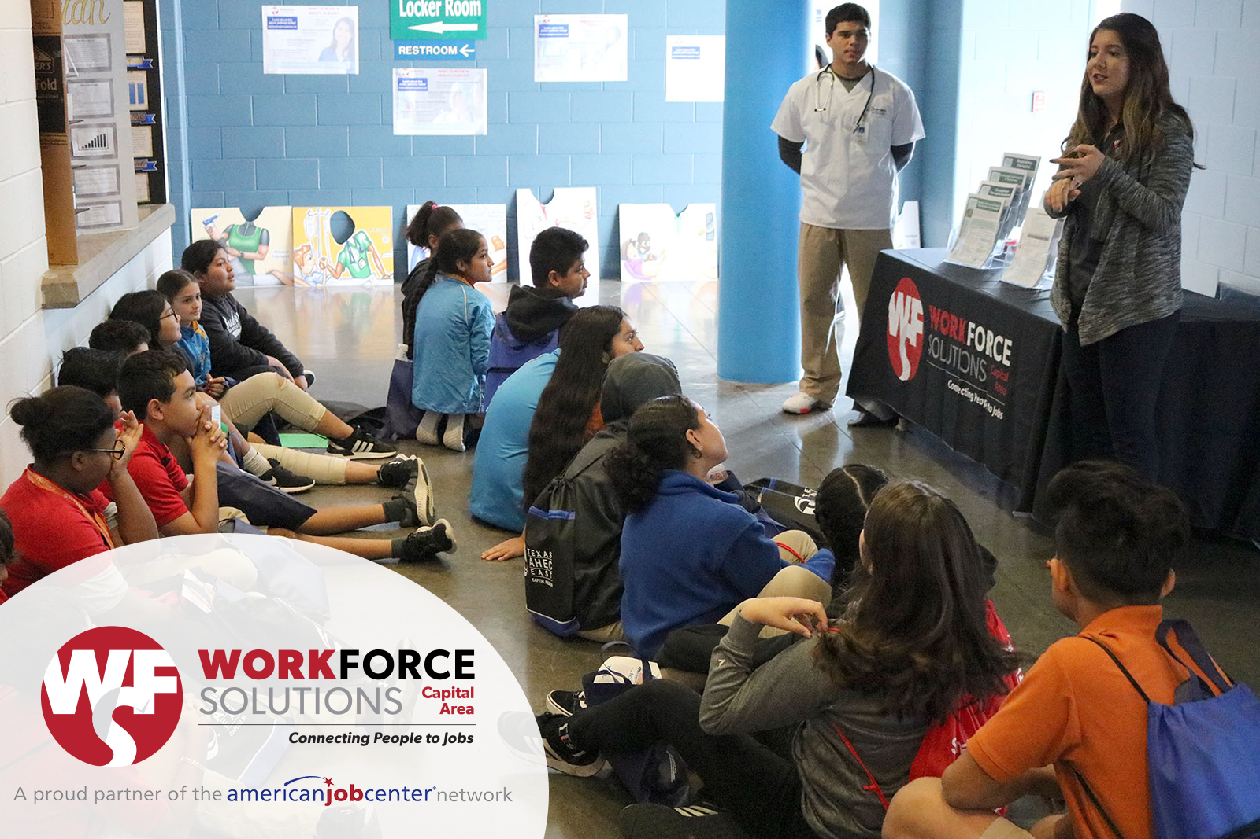
Capital Area

Slide 23
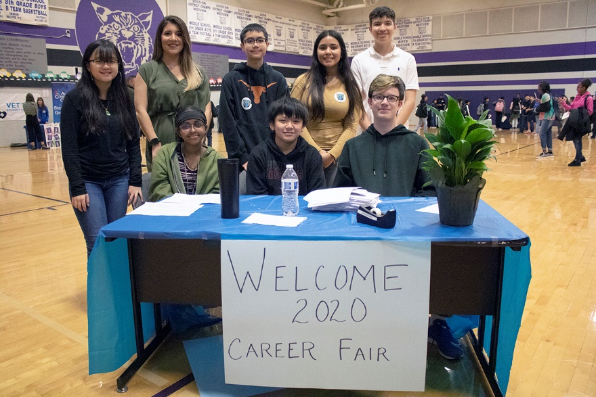
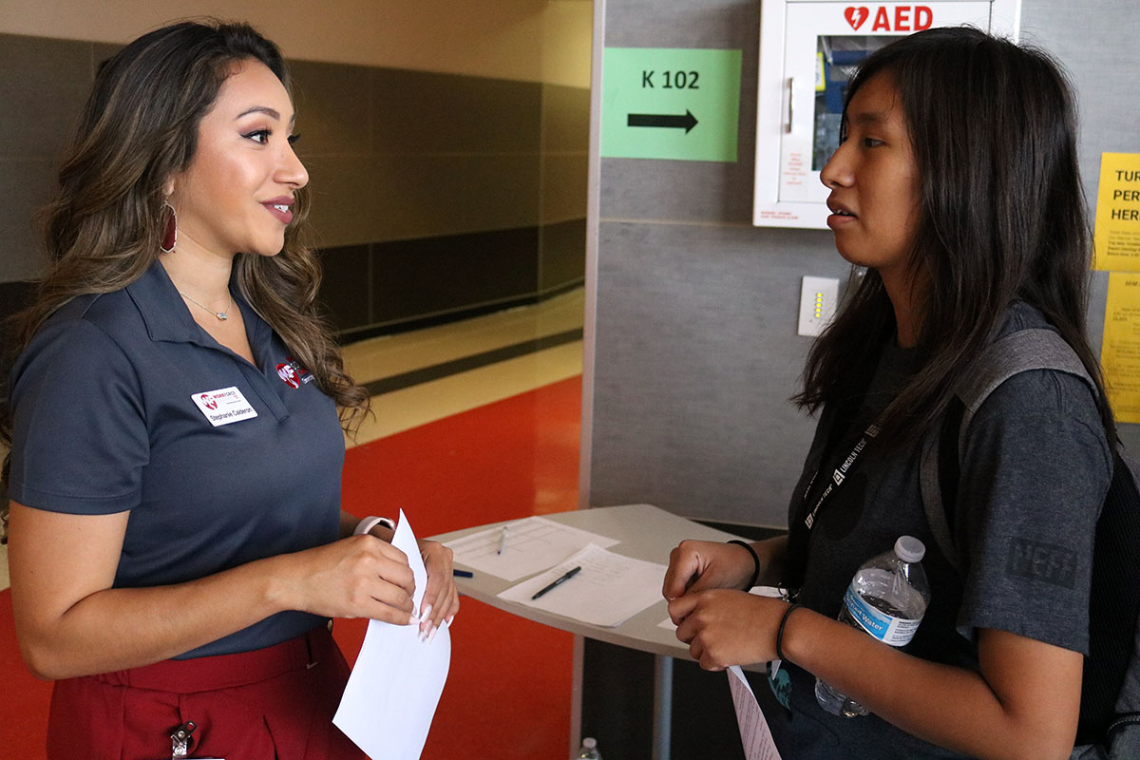

Capital Area 2

Slide 24
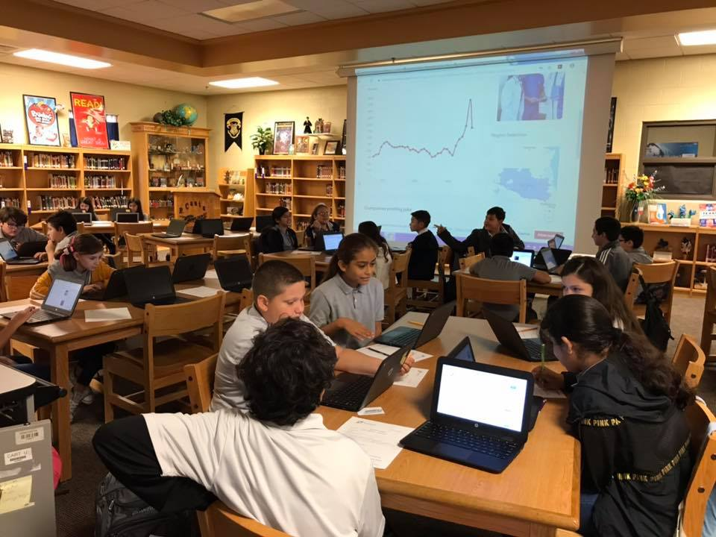

Lower Rio Grande Valley

Slide 25
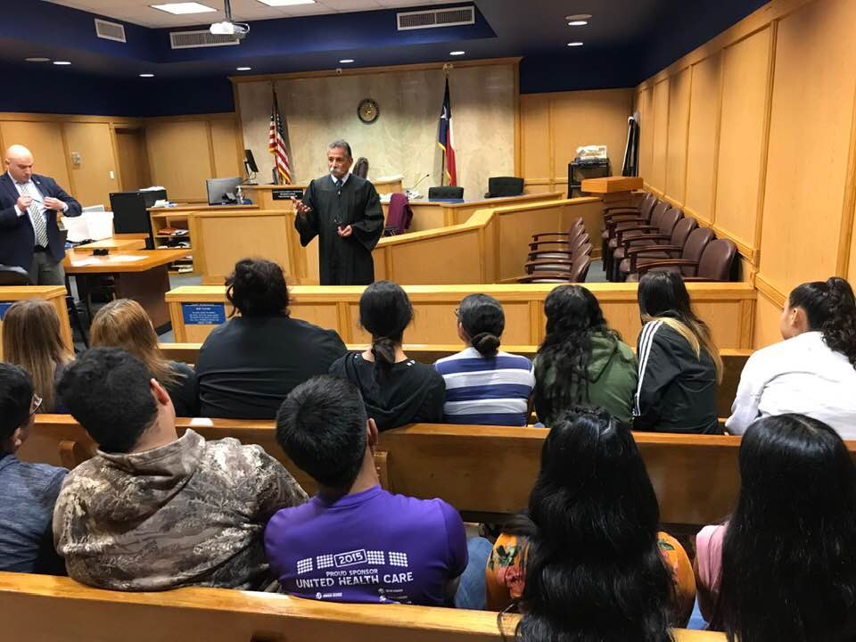
Lower Rio Grande Valley 2

Slide 26
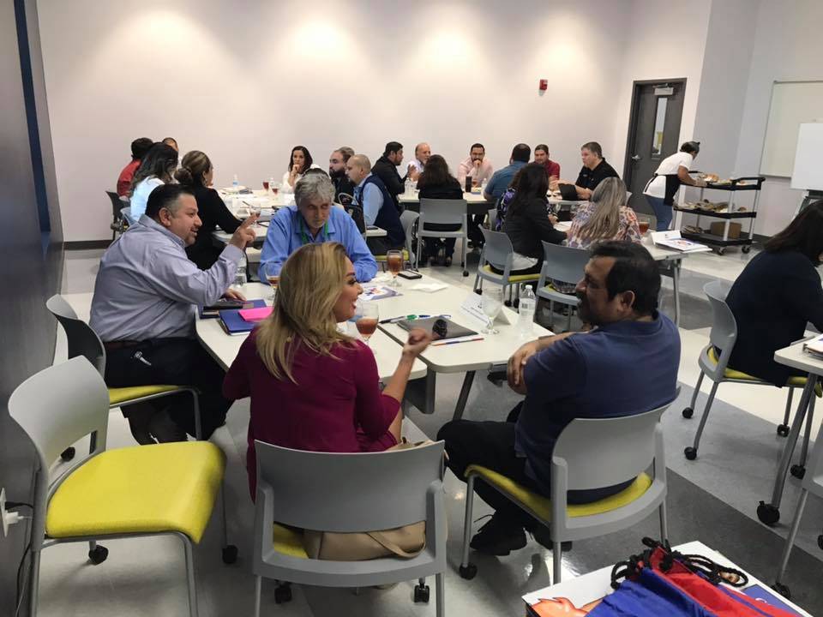
Lower Rio Grande Valley 3

Slide 27
West Central Texas

Slide 28
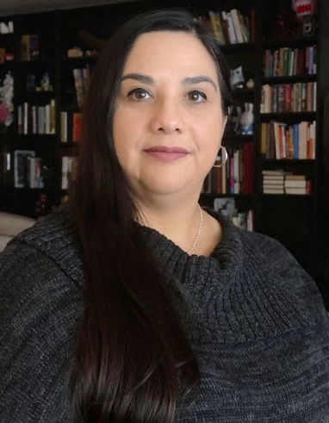
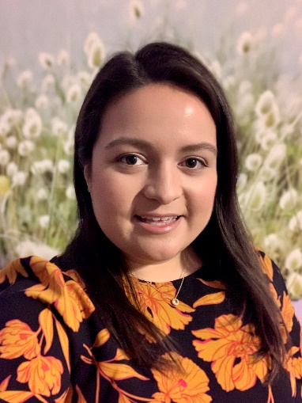
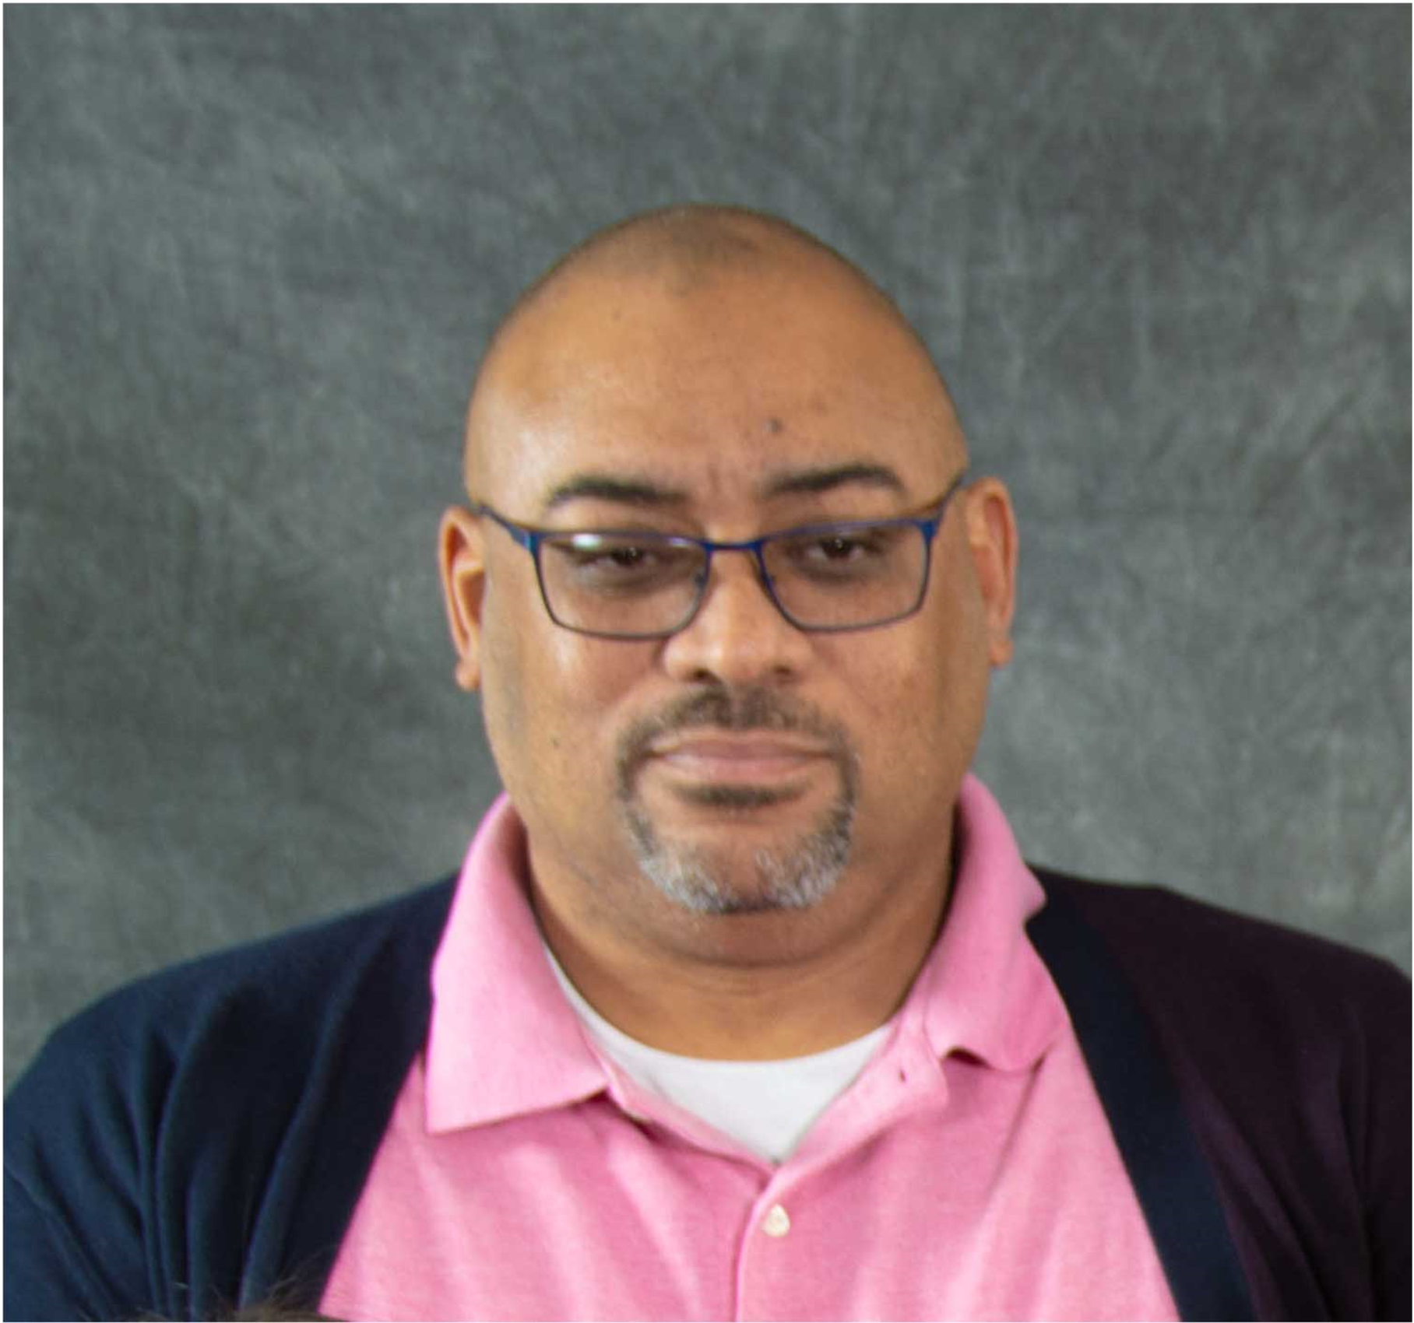
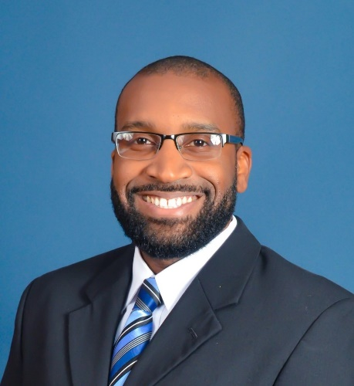
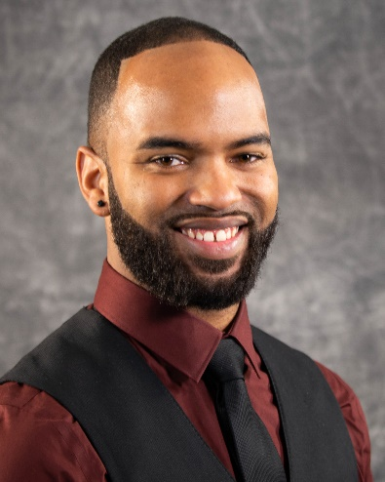
Our Team Covers the State
Lori Knight
Manager & Outreach
Cristina Jaime
Editor & Graphic Design
Major Jones
Outreach
Ronny Washington
Outreach
Jonathan Butler
Outreach
Notes:
Presenter- Let me start by introducing you to our amazing Education Outreach team. I am Lori Knight and I manage the outreach team as well occasionally provide outreach services as well.
Cristina Jaime is our Editor and she provides graphic design support for the team as well.
And our three Specialists, Major, Ronny, and Jonathan provide outreach services to schools across the state.

Slide 29

We’re creating
Publications
Digital Content
Video Library

Slide 30


https://tinyurl.com/TWCpubs
Career success Workbook
Career portfolio
Coming
Soon
Notes:
There are two different documents we are talking about here. The Career Success Workbook and its companion High School Career Portfolio. Both of these documents will be made available for download on our publications page as soon as they reach the distribution phase. You will find them soon at https://tinyurl.com/TWCpubs

Slide 31

Financial Resources and Planning
Beyond High School

Slide 32

Works in Progress
Elementary Assessments
Career pathways
Career Cluster Poster Set
Soft skills
Overcoming Barriers to Employment
“My First Job”
Closing the Middle-Skill Gap
0%
100%
Notes:
In fact, Career Success, our high school level career readiness workbook was recently released, and it took up a large bulk of the year. This project was a major overhaul of an older document. Not only did we rewrite a large portion of it, but we shrunk the size of the document from a newspaper tabloid to an 8x11 workbook. We also updated all of the data included and completely revamped the graphic design and layouts of the pages. While we were working on this mammoth project, we were also adding more new content to our to-do list.
Currently we are working on replicating what we did with the Career Success project but with the publication Career Investigations. This is our middle school version of the career readiness content.
Simultaneously, we are working on bringing you new publications focused on financial planning for all the options beyond high school, career pathways, soft skills, overcoming barriers to employment, and tackling and succeeding in your first job. These additional resources may take some time for us to complete, as they are all in various stages of production, but know we are diligently working on getting them to you.
Our plan is to release digitized versions of all of our new publications when they are officially launched in print. We encourage you to visit our website periodically to check on the progress of those workbooks and publications or pay close attention to any TWC emails you may get in the future as we plan to announce each new document when it reaches the distribution phase.

Slide 33

We Share the Content & Files
AEL
Regional Outreach Teams
Anyone else
Notes:
Specifically, we have plans to share it with the TWC, AEL team so they can adapt the content for their adult audience. We will also share it with our Regional Education Outreach teams so they can add their own logos and contact information, so students know they have access to local professionals who provide education outreach services.
We are also open to share our files with others. Again, we don’t copyright our materials, so the content will be available for public domain use as soon as it is posted to our website, but feel free to send the request if you are wanting InDesign files rather than PDF’s or if you want to partner with our team in any way. Simply reach out to our team with a request and we will share with leadership.

Slide 34

Contact Information
Lori Knight
512-463-4879
Lorena.knight@twc.texas.gov
careerinformation@twc.texas.gov

Slide 35
My Question for YOU
How can our teams work together?

Slide 36
Thank You
What Questions do You have?

