Slide 1
Advisory Committee Meeting
Wednesday
December 1, 2021
1:30 pm CST
Adult Education and Literacy

Slide 2
TWC Welcome
  AEL State Director Opening Welcome
  Commissioners Opening Remarks

Slide 3
Thank you, Members!
Departing
New and Continuing
Donald Tracy
David Barron
Traci Berry
Paul Fletcher
Samuel Keeler
Diana Contreras (2nd Term)
Jauneen Maldonado (New)
Steve Banta (New)
Brenda Schofield
Rita Hernandez

Slide 4

Departing Members
Remarks

Slide 5
Introductions – New Members
Jauneen Maldonado - AEL Director, Workforce Solutions Tarrant County
Steve Banta – Executive Director, Literacy Texas

Slide 6
TWC AEL Updates
Future Workforce Awards
HSE Voucher Program

Slide 7
Future Workforce Awards
Focus on outcomes (enrollments, credentials, increased skills)
Engagement between AEL program, Boards, and Vocational Rehabilitation
Recognizing our customers – Adult Scholar of the Year

Slide 8

2022 Workforce Conference
1st Place - $75,000
2nd Place - $50,000
3rd Place - $25,000
Best in Class ($)
Co-Enrollment ($)
Texas Adult Scholar of the Year (6 scholars)

Slide 9
High School Equivalency Subsidy Program
TEC §48.302 (amended HB 1525)
Subsidizes HSE exams for eligible Texans 21+
TEA/TWC contract, $1.5M
Managed locally by AEL programs

Slide 10
Committee Discussion
Digital Skills Presentation
Recommendations for Commission

Slide 11
The Community’s College
Community Education & COVID

Slide 12
The path through college does not start at our door...

Slide 13
Vision & Mission
We are the Community’s College and our Mission is to build bridges to success for our students through accessible and affordable educational opportunities that meet their needs, where they are...

Slide 14
How we achieve this
PARTNERSHIPS
SAFETY
MOBILE
NATIVE
FLEXIBLE

Slide 15
Challenges
BUILDING TRUST
STUDENT
MINDSET
LIFE CHALLENGES
PARTNERSHIPS
MANAGING INSTRUCTION
NON
TRADITIONAL
MODELS
STAYING SMALL
FINANCIAL
LIMITATIONS

Slide 16
COVID

Slide 17
NEW CHALLENGES
STUDENT SAFETY
DIGITAL EQUITY
SUPPORT SERVICES

Slide 18
PIVOT
REGROUP
REDESIGN
RE-ENGAGE

Slide 19
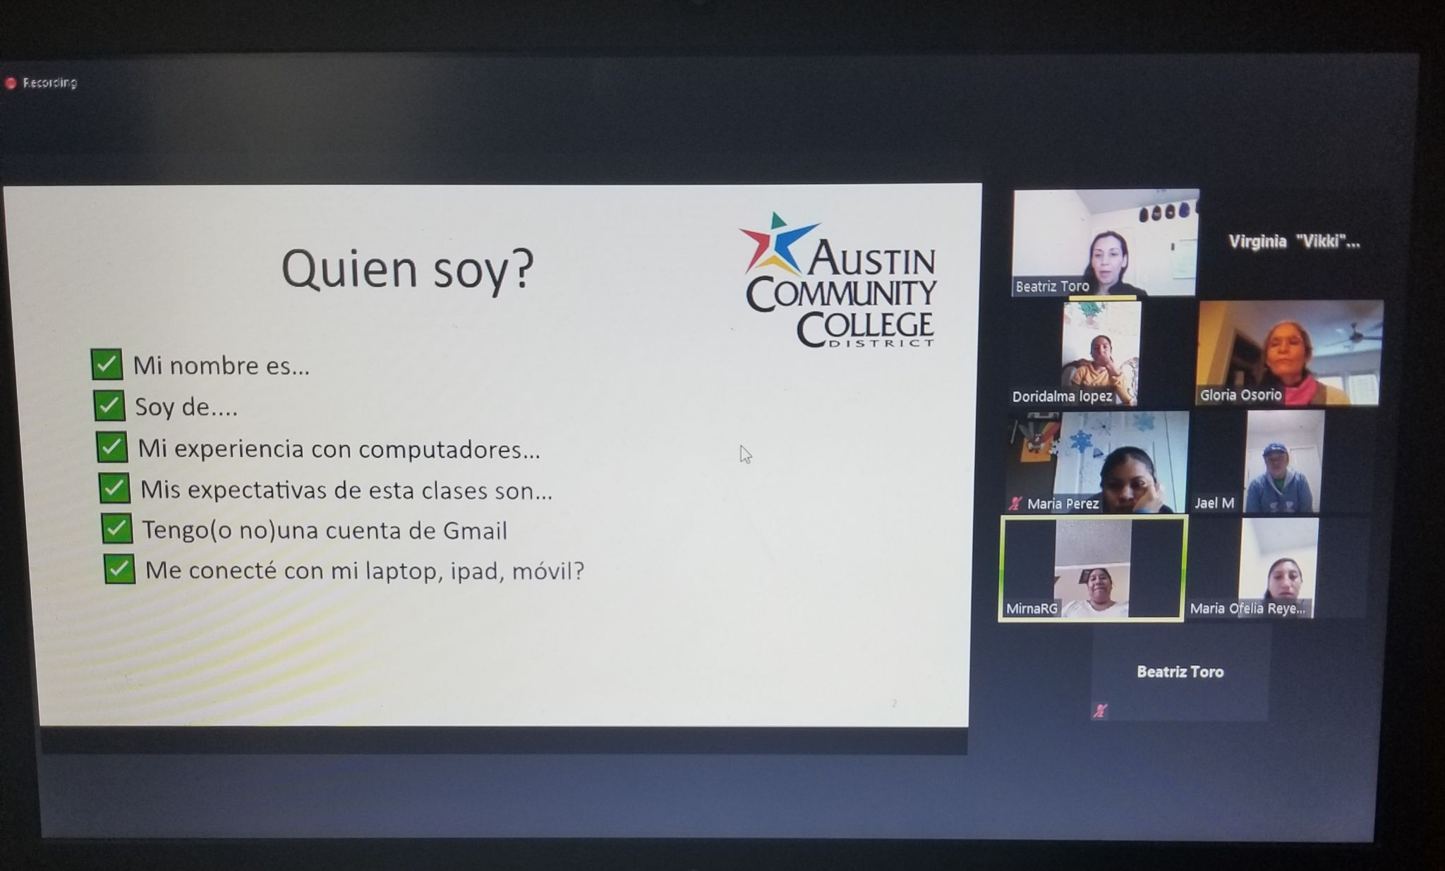
ACC Virtual Class

Slide 20
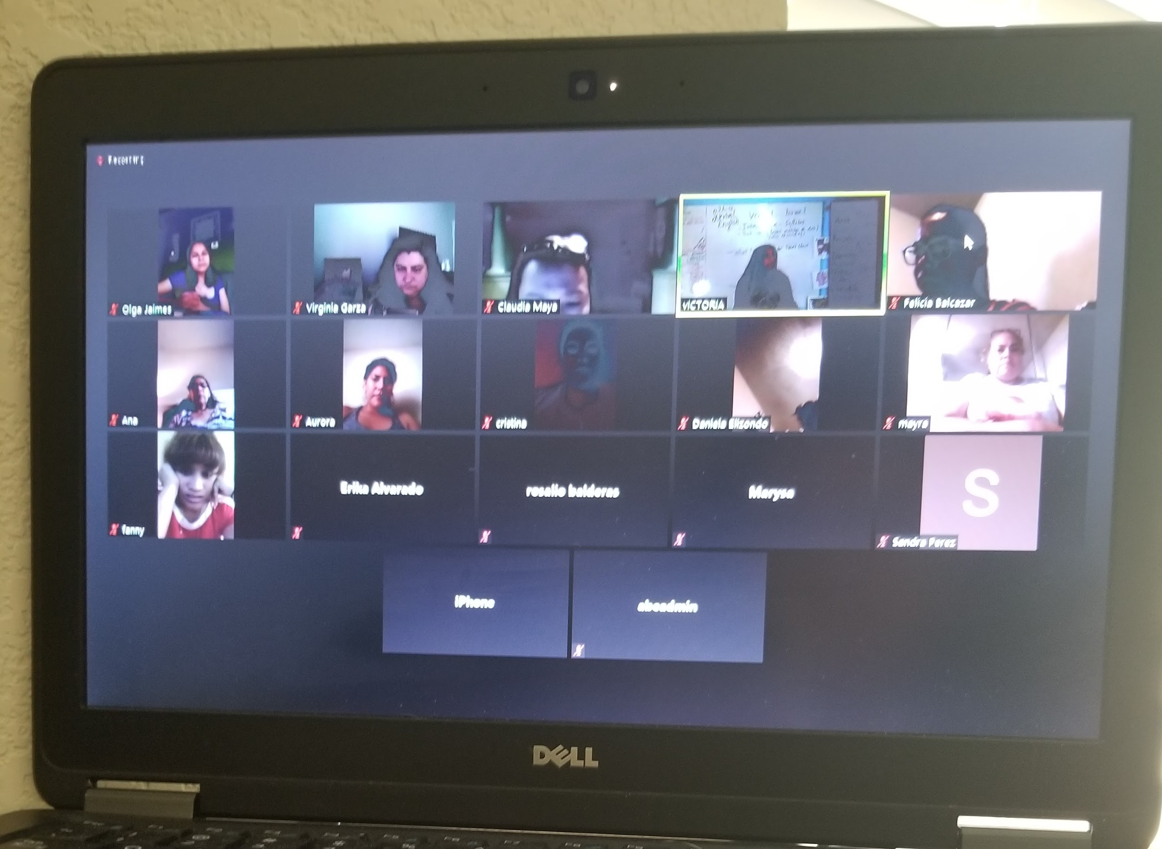
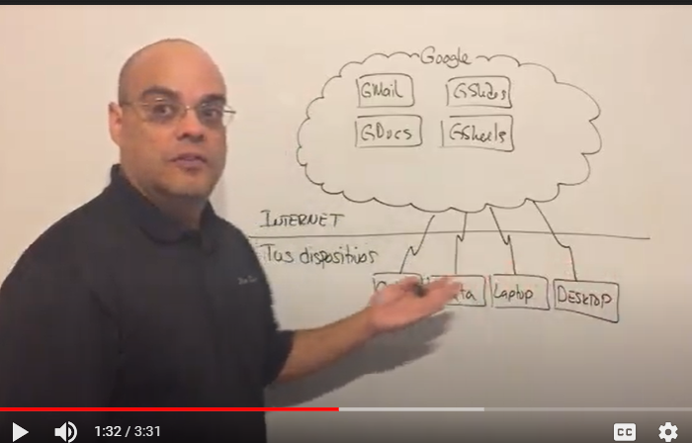
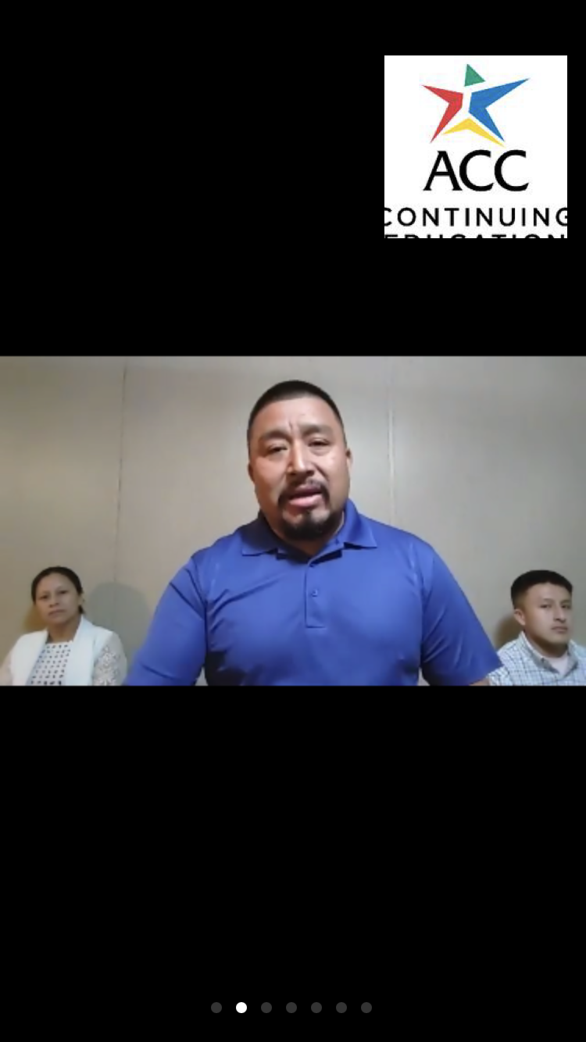
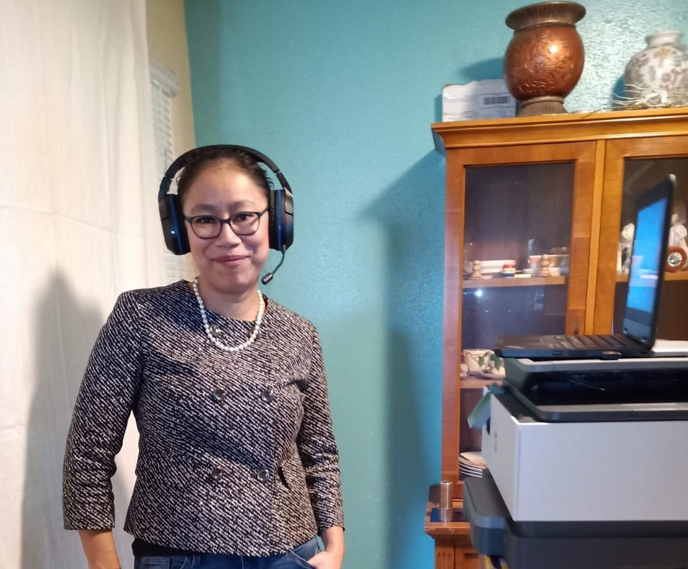
ACC Virtual Classes

Slide 21
DURING THE PANDEMIC
300
DIGITAL LITERACY
60
Trainer
DIGITAL LITERACY
200
TEACHER ASSISTANT
100
BASIC ENGLISH

Slide 22
QUESTIONS?

Slide 23
Committee Recommendations & Discussion
Digital Skills: Basic literacy & entry technical skills needed for workplace
Career Readiness: Employability & market--valued vocational skills)
Reentry / Barriers to Entry: Justice-involved, veterans, etc.
Support Service Networks: Expand 2020 recommendation on faith-based, community-based, non-profit organization engagement

Slide 24
Closing Remarks

Slide 25
See you in 2022!
Meeting Dates TBD
Have a wonderful holiday!

